Slide 1
Software Engineering and Architecture
Broker II
Object References

Slide 2
TeleMed Limitations
TeleMed was a three-wheeled bicycle ☺
  Only one object :TeleMedServant
  Only one class TeleMedServant
  Object id was given by domain Patients unique ID
    That is, CPR is provided to TeleMed – allow getting Inger’s data…
We need to ride an ‘ordinary bicycle’, like HotStone
  Multiple objects Multiple Cards, Heroes
  Multiple classes Card, Hero, ...
  ‘new StandardCard()’ On the server!

Slide 3
New Case: GameLobby

Slide 4
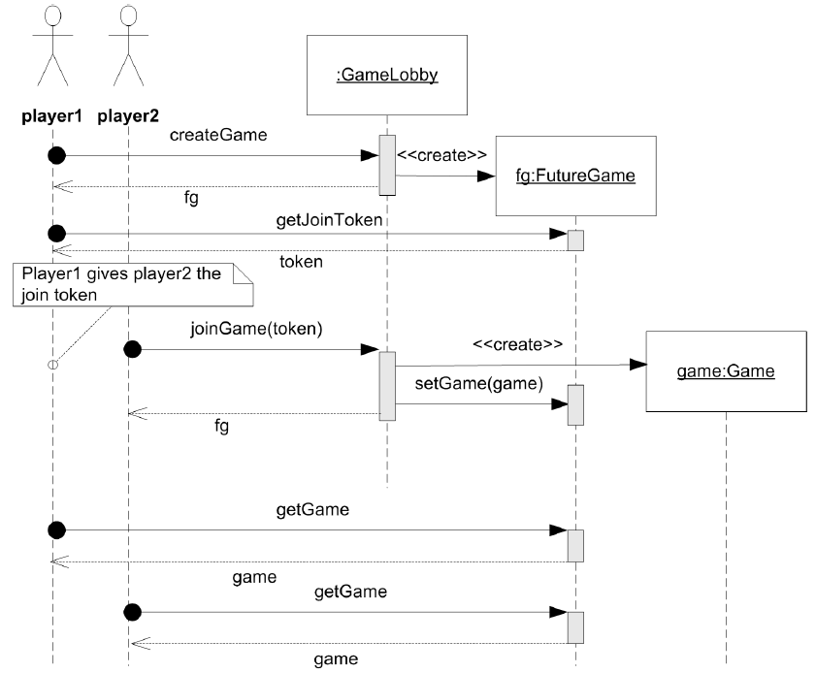
Dynamics
Side note
  Perhaps a bit
  ‘convoluted’ design
  but…
  Lots of ‘remote
  references’ to pass
  to the clients…

Slide 5
New Case: GameLobby
Challenge:
Server creates game object
But only when two players enrolled
… by creating a ‘FutureGame’ object as stepping stone

Slide 6
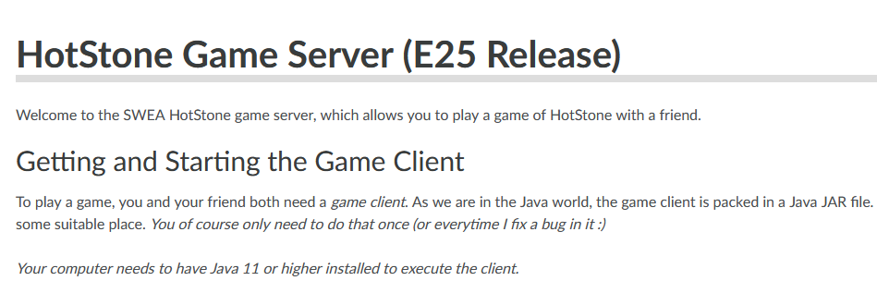
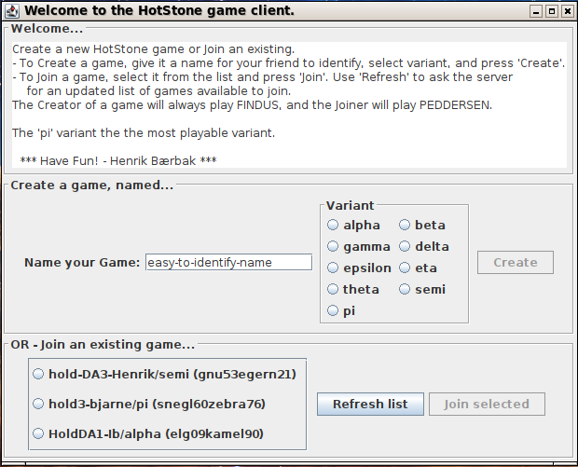
Side Note
GameLobby’ish design is used in my game server on hotstone.littleworld.dk

Slide 7
Roles

Slide 8
Roles
Distributed systems always have some kind of ‘singleton object’ – the hardcoded ‘first reference/entrypoint’ of the system

Slide 9


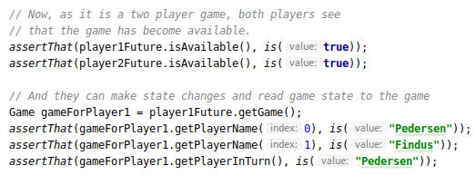
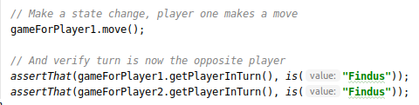
Test Code View (Client side)
Pedersen must tell Findus what the token is…

Slide 10
The Positive Viewpoint
Let us approach the problem from the viewpoint of status: what does work on the ship? [Apollo 13 Movie ☺]
  What can our Broker already handle?
Three Java interfaces in the GameLobby system
  Yep: We can make ClientProxies and Servants for the three roles
    GameLobby, FutureGame, Game
  Yep: Marshalling method names, arguments
  Yep: IPC, nothing new here either
  Invoker: Quite a few methods in the invoker, but Yep, we can do that – just put more if’s into the thing...

Slide 11
But...
The culprit is the method call on client:
On the server, createGame(), will create and return a FutureGame instance, but we cannot pass by reference.
  We can only pass by value
    Strings, integers, DTO/POJO, Record type (json stuff)
On the client, we only have ClientProxies, right?
  If we pass-by-value ‘player1Future’ then no interactions across the two clients, just get a copy-of-values on their local machine…

Slide 12
Revisit
This is the deep and hard problem
We create an object on the server (object reference to something on the java heap (=a memory address))...
But a memory address/object reference is only valid on the server
  A pass-by-value of it does not make sense on the heap of the client!
:Server
:FG
:Client
?

Slide 13
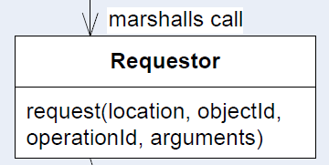
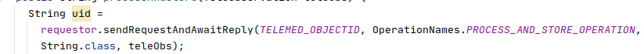
The Insight
The key insight is
  How does ClientProxies address their associate Servant objects? Through the ‘objectId’ parameter of the requestor call…

Slide 14
The Insight
The key insight is
  How does ClientProxies address their associate Servant objects? Through the ‘objectId’ parameter of the requestor call…
So –
  the server must return a unique objectId of the object, not a reference to it
  the client proxy must create a proxy, and associate it with that particular objectId
If you do not see this right away...
It is because it is one of those ‘aha’ things ☺

Slide 15
Client Side
How does this look?

Slide 16
Client: GameLobbyProxy
So, the ClientProxy code becomes
That is, objectId replaces object reference

Slide 17
The Concept
Concept / Template
  ClientProxy methods that return object references must
    1) Get an objectId from the server
    2) Create an appropriate ClientProxy, and assign that objectId to it

Slide 18
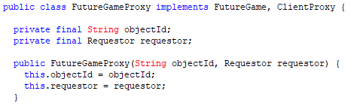
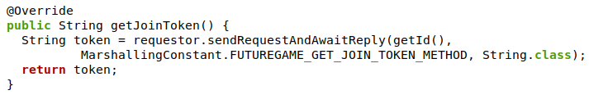

ClientProxy Constructor
That is, the objectId from the server must be assigned during client proxy construction, alas, in the constructor
… which is then used in all subsequent proxy methods:

Slide 19
The pass-by-reference problem!
c1:
Clientproxy using ”id1”
c1: (“id1”)
C013
c2:
ClientProxy using ”id2”
c2: (“id2”)
C017
c52:
ClientProxy using ”id52”
c52: (“id52”)
C226
Client program
Server program
CS@AU
Henrik Bærbak Christensen
19

Slide 20
Server Side
How does this look?

Slide 21
Server: Invoker
The Invoker’s code’s first part is the normal upcall...
But, - how do we assign a unique ID to the FutureGame?
Sigh – we have a new responsibility someone must have

Slide 22

I will assign it to...
The Servant object
Java’s library for creating unique IDs
That is: Servant objects will generate a unique objectId during construction; and provide a ‘getId()’ method...

Slide 23
But...
The responsiblity could have been assigned elsewhere:
  The invoker that generates a unique UUID
  A Name Service that we ask to assign a UUID
  Domain already defines a unique ID
  Storage tier (RDB) generates unique Ids / Primary Key
  ...
As usual in this course, each possible design decision have certain advantages and disadvantages
Exercise:
  What disadvantage has my decision? Advantage?
Notes:
Disadvantage: We add a responsibility (id generation) to the role(s). Advantage: Our invoker does not do a lot of ID handling and generation itself.

Slide 24
Server: Invoker
Thus the Invoker’s code’s last part is different – instead of returning the servant’s return value directly (pass-by-value), it must return the return value’s objectId (pass-by-reference)

Slide 25
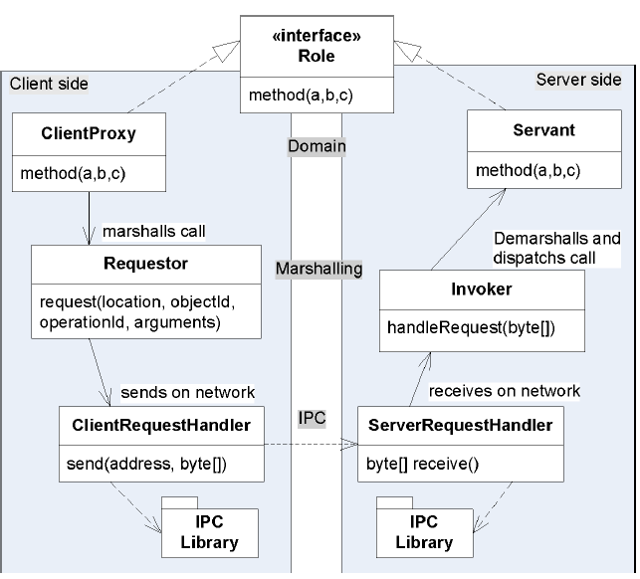
Summary so far
2
1
3
4

Slide 26
Next Issue
Next…
But what happens when client uses the player1future?
This is now a client side FutureGameProxy getJoinToken() call...
?

Slide 27
Next Issue
But what happens when client uses the player1future?
FutureGameProxy’s implementation is easy enough, the return type is just a String (pass by value)
?

Slide 28
But... In the Invoker?
Someone is responsible for knowing the relation between objectId and actual servant object reference!
  name service ☺
Someone is responsible for storing the relation.

Slide 29
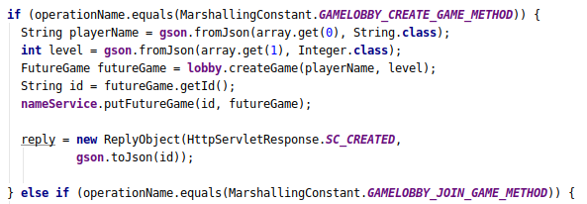
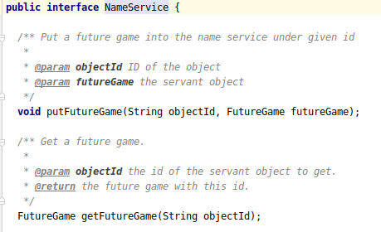
So - Update
I let the Invoker update a name service at ‘create time’:
A non-distributed name service
Note: this is in the ‘createGame’ code

Slide 30
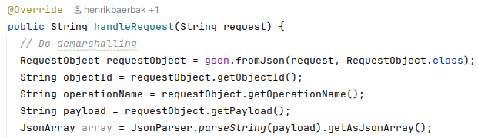
Final Piece...
Now Invoker code can be completed for handling the FutureGame’s getJoinToken() method
  Retrieve the object reference based upon the objectId sent by the client side proxy
    It is part of the RequestObject that we demarshall in ‘handleRequest()’

Slide 31

Final Piece...
Now Invoker code can be completed for handling the FutureGame’s getJoinToken() method
  Find the associated FutureGame object associated with ‘objectId’ in the name service
  Do the upcall on that particular object
  Marshall the return value and return that back to ServerRequestHandler

Slide 32
Or - in Pictures…
Server creates a FutureGame in memory at 0106h
Client
Server
futureGame = ????
0100h
0102h
0104h
futureGame
0106h

Slide 33
objectId and NameService
The address is abstracted by a unique objectId
Client
Server
futureGame =
objectId (‘08af’)
NameService
0100h
(‘08af’, 0106h)
0102h
’08af’
(‘d772’, 0100h)
0104h
futureGame
0106h

Slide 34
Discussion
My name service is an in-memory data structure
  Does not work if server crashes ☺
  Does not work in case of horizontal scaling
    That is: Many copies of the same game server
Production systems need to keep the name service directory in a tiered persistent system
  Database Slow RDB
  External cache Faster MemCached/Redis
  Internal cache Fastest MemCached/Redis

Slide 35
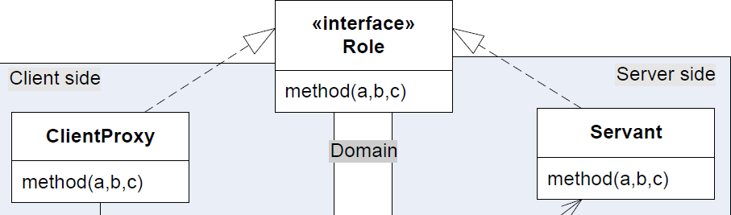

Discussion
Be aware that for given a given role...
... Not all methods are necessarily remote calls!
Example: method getId()
ClientProxy
Servant

Slide 36
Exercise
Example: method getId()
Exercise:
  Why is it extremely stupid to make the client side proxy ‘getId()’ into a remote method?
ClientProxy
Servant
Notes:
Because the client proxy needs its objectId in the request call, so it becomes ”to get my id, I need to send my id”. I have actually seen student solutions that do exactly that, sigh...

Slide 37

Role Interfaces Again
Both our Servant and Proxy objects must be ‘identifiable’, ala, implement the ‘getId()’ method…
In my HotStone I have
a Role Interface for that…

Slide 38
Pass-by-Ref – but only one way
So – status… What can we do?
  Pass by value
    From Server to Client ala return values
    From Client to Server ala arguments in parameter lists
  Pass by reference
    From Server to Client ala objectId, proxies, name service
    From Client to Server yes and no!

Slide 39
Client-to-Server References
We actually have two cases
  A) Client creates an object, pass the ref to the server
  B) Client pass the ref of an object on the server to the server
The first case, A), is not possible with FRDS.Broker.
  It would allow the server to call methods on client objects…
    Generally, a bad idea (security, availability, performance)
The second case, B), is OK.
  … How ?

Slide 40
Client pass Object Ref
Exercise: How do a client pass an object ref?
The GameClientProxy must
  ‘sendRequestAndAwaitReply(objId, opName, Status.class,
  who, WHAT?, atIndex);
  We cannot replace ‘WHAT?’ with ‘card’ because ‘card’ is a client side object reference, referring to a CardClientProxy.
    The server has no idea what that memory adress is!
Exercise: What does the client need to send instead?

Slide 41
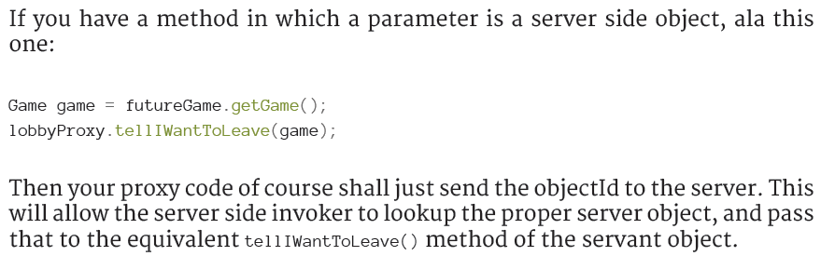
Client-to-Server References
The technique is:

Slide 42
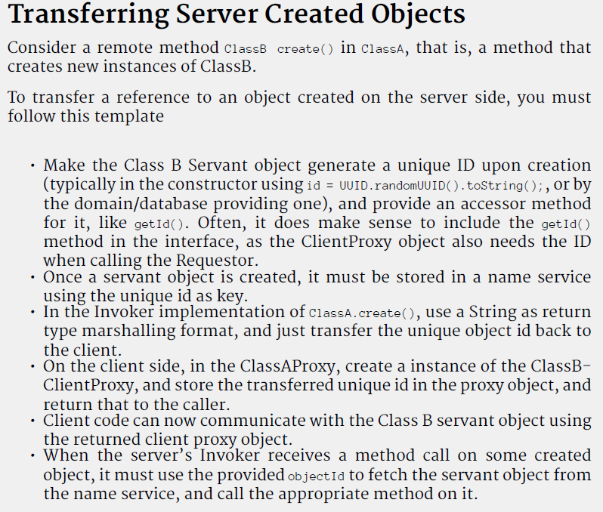
Summary
Recipe:
  createObject()

Slide 43
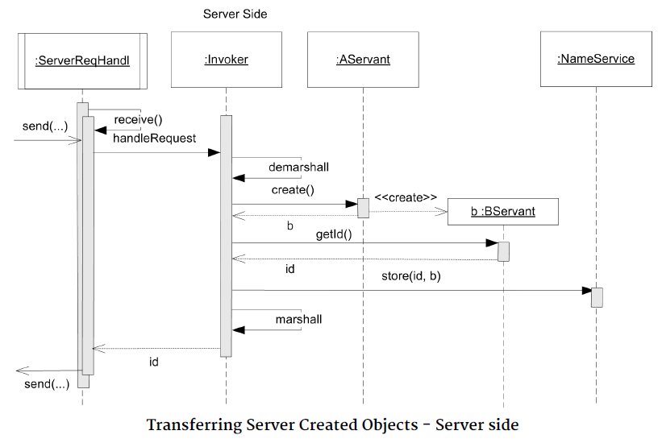
Summary

Slide 44
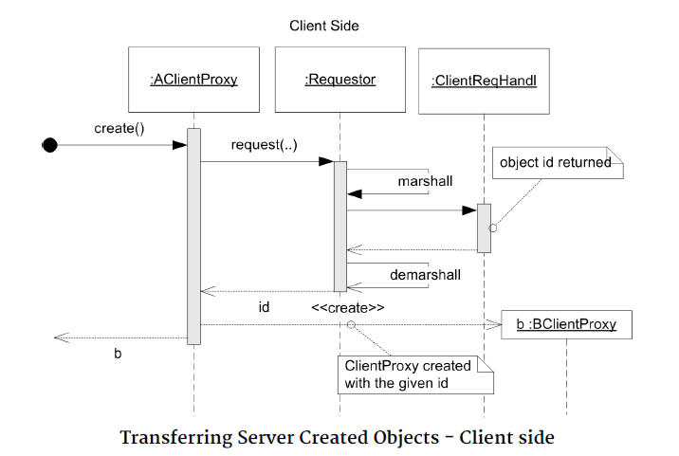
Summary

Slide 45
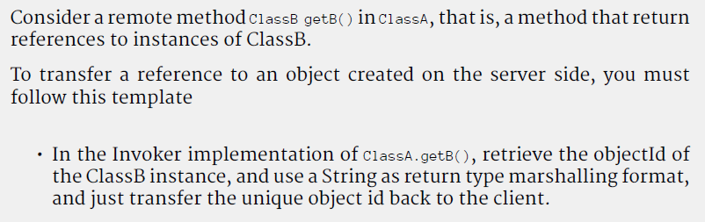
Summary
Recipe:
  getObject() (just getting a server side object)

Slide 46
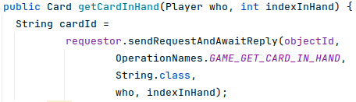
The Proxy Explosion
One issue:
If I call this twenty times on the same (who, index), how many proxy objects do I create?
What is the issue here?
  Is it a big problem?
  Still, can it be avoided?
Notes:
We create new proxy objects even though these 20 different proxies all point to the same server side object. A waste. Java will garbage collect the ones not used.
But we can solve it – by using a client side name service. But it complicates the code, so avoid that in the mandatory!

Slide 47
The Client-Server Argument
Java RMI - and
Why it was a bad idea ☺
(Or a good idea that was misused)

Slide 48
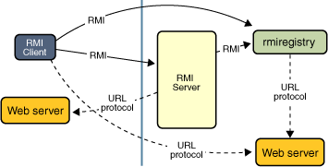
Java RMI
<<interface>>
Remote
Idea:
  Let Java generate the ClientProxy and Invoker!
Let your Role interface extend ”Remote”
  I.e. you have already high coupling to RMI ☹
Normal Java compile
  Will call ‘rmic’ tool which will generate (see next slide…)

Slide 49
That is…
The ‘rmic’ compiler will produce not one class file but two:
<<interface>>
Role
foo()
Client
RoleClientProxy
RoleSkeleton (invoker)
As well as provide library classes of the rest of the roles: Requestor, Client- and ServerRequestHandler
RoleServant

Slide 50
CORBA/RMI/.NET Remoting
Early Broker systems strove to achieve one ability:
  Transparency
    Ideally, you program as you normally do in OO, ignoring the fact that some objects where on the server
Thus any (remote) object may invoke methods on any other (remote) object.
Observer pattern is a good case
  Game game = new MyFantasticHotCivGame(…);
  Drawing drawing = new CivDrawing(game);
  game.addGameObserver(drawing);
Now game and drawing can call each other, and will!

Slide 51
This is not Client-Server
Client-Server Architecture
  Many active clients that queries a single reactive server
But the observer pattern is two way
  Both client and server are active and reactive
GameProxy
playCard
GameServant
GameObserver
onPlayCard
Now Server is active and call the client!
A Peer2Peer Architecture!

Slide 52
The Peer2Peer
Benefits
  Now we can actually code a server, which updates the GUI on the client!
GameProxy
playCard
GameServant
HotStoneDrawing:
GameObserver
onPlayCard

Slide 53
But…
The system is more fragile!
  Clients come and go all the time while servers are much more resilient (ideally stay powered on forever, never crash).
    Lots of server logic to handle disappearing clients
  Servers becomes tightly coupled to clients
    Server behavior relying on behavior on clients
  Scaling the server is difficult
    The server becomes statefull (has to know it’s clients)
    Horizontal scaling (more servers) is therefore harder
  Performance suffers
    Server calling 100.000 clients is slow!
  Security is harder
    The server invokes code on my machine!

Slide 54
But…
A personal belief (no scientific facts here) is that the transparency aspect of RMI lead architects to create ‘big ball of mud’ networks of interconnected remote objects
  You need to be extremely aware when method invocations are remote and when not!
Why?
  Because the semantics is so much different
    Methods fail
    Methods execute 275 times slower
    Methods may be controlled by hackers…

Slide 55
And Coders Then Chose REST!
REST is ‘using HTTP as intended’
REST architecture is a pure client-server architecture
  You always pass data purely by value
    Mediatypes like XML, HTML, JSON
      ”No” security issue
  You never see the server call back to you
  ObjectId as we use is basically a ‘resource identifier’ = URL
    Hotstone.littleworld.dk:5220/game/a476/card/7b534

Slide 56
So
So... To code remote systems…
... Software architects must carefully and explicitly decide which method calls/objects are remote!
Thus, adding the extra ‘generate ID’ behavior in our remote objects are in line with this explicitly...

Slide 57
And – of course
… You sometimes need ‘calling back to clients’
  Games are a good example
    Servers call back to clients when opponents do stuff!
  Streaming vido/audio
  Web feeds, chats fora, … WarpTalk :)
Lot of tricks to actually do so
  “Comet”, long polling, server-sent events, WebSockets, …
Morale: Do it if necessary, not by accident!

